Slide 1




CODEBASICS
RESUME CHALLENGE
DESIGNED AND CREATED BY ADITYA BHARDWAJ

Slide 2

CONTENT
01
INTRODUCTION TO ATLIQ MART
02
OUR TEAM
03
STRATEGY
04
OUR SERVICES
05
EXPERIENCE
06
QUARTER
07
NEXT PROJECT

Slide 3
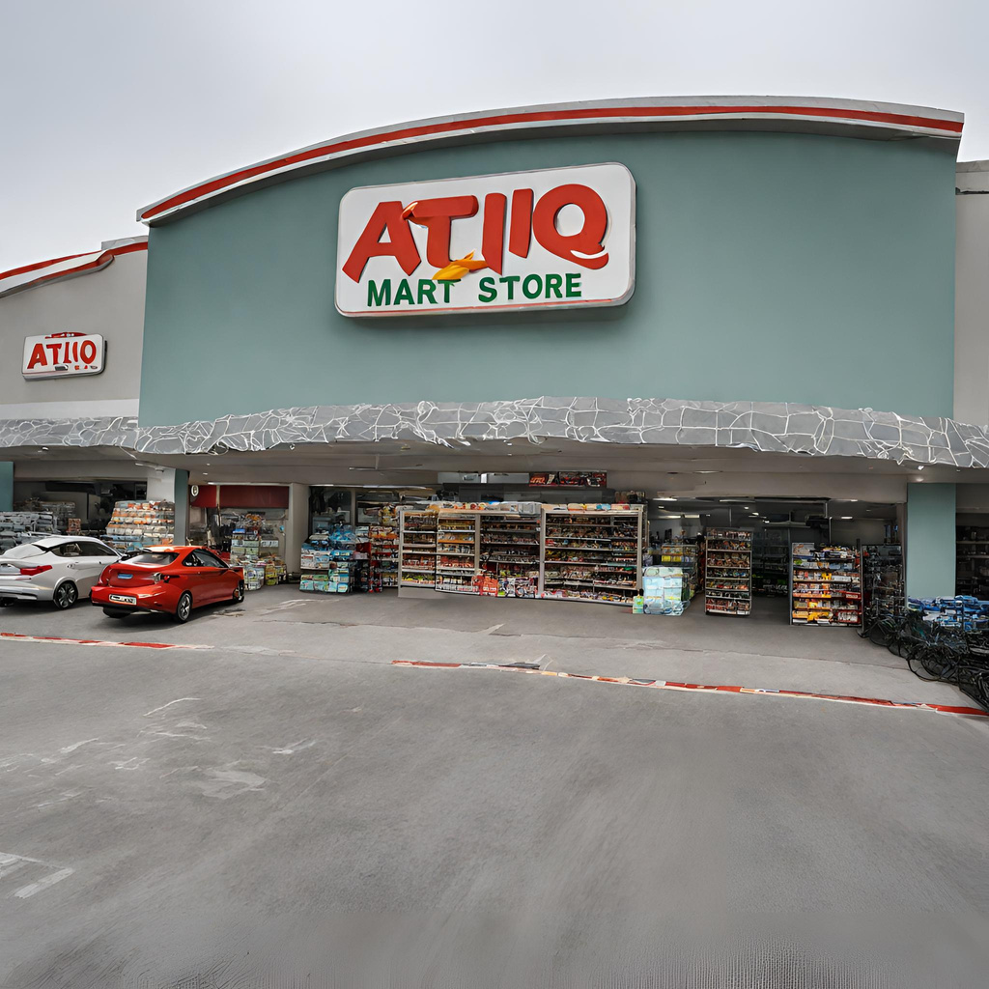



INTRODUCTION TO ATLIQ MART
AtliQ Mart is a retail giant with over 50 supermarkets all over in the southern region of India
They have their own product brand also Called AtliQ

Slide 4






GOALS AND OBJECTIVES
Objective n° 1
Objective n° 2
Objective n° 3
To provide quality products at low budgets to the customers
Improve their Promotional sales in different cities and stores
To generate more profit and revenue during promotional sales

Slide 5



VALUES
Mission
AtliQ Mart Sales Director Mr. Bruce Haryali wanted to know about the promotional sales which campaign was good, which promo type did the best, and wanted to dig deep into the insights.
Vision
Our Vision is to analyze the data and get the insights by their Store Performance, Promotional Performance and their Products and Category performs by their generated revenue and sold units

Slide 6



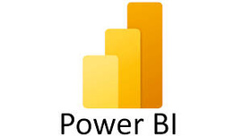
TASKS AND TOOL USED
01
02
03
STORE PERFROMANCE
PROMOTION TYPE
PRODUCT AND CATEGORY
Top 10 stores in terms of Incremental Revenue (IR) and bottom 10 stores when it comes to Incremental Sold Units (ISU)
during the promotional period
Top 2 promotion types that resulted in the highest Incremental
Revenue and bottom 2 promotion types in terms of their impact on Incremental
Sold Units
Categories saw the most significant lift in sales from the
promotions.
Are there specific products that respond exceptionally well or poorly to
promotions?

Slide 7
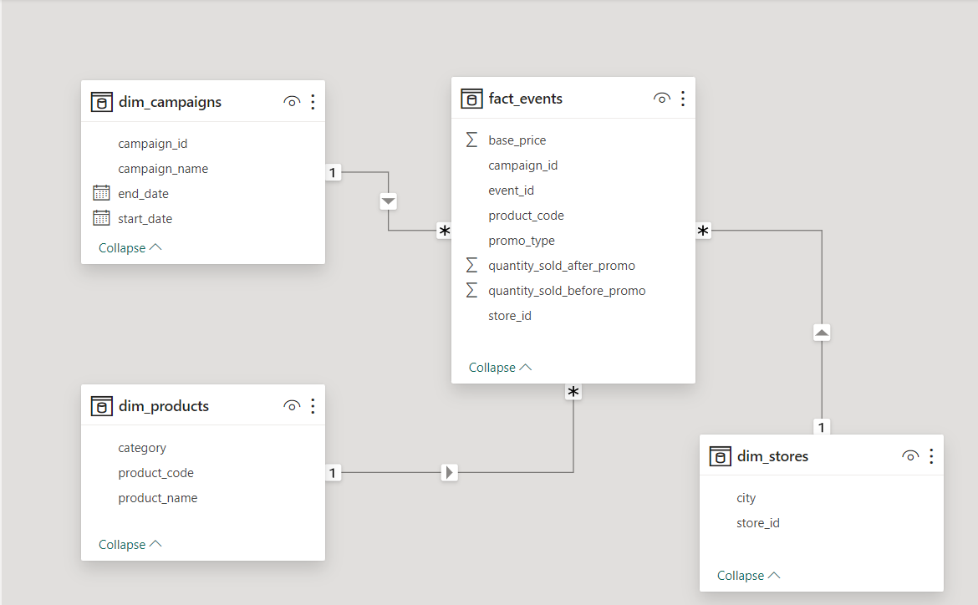
OVERVIEW OF SAMPLE DATASET

Slide 8
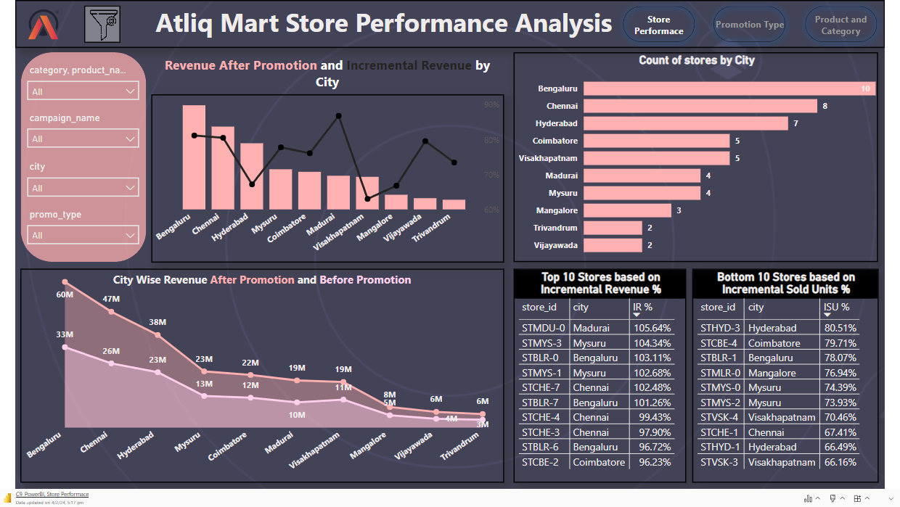

Slide 9

STORE PERFORMANCE ANALYSIS AFTER PROMOTION
Count of Stores and City: There are 50 supermarkets distributed in 10 different cities. Bengaluru has the highest number of stores - 10 and Trivandrum, and Vijayawada have the least number of stores 2.
Revenue and Incremental Revenue %:
Most Revenue Generated by the city was directly linked with the number of stores present In the city.
The highest Incremental Revenue % was seen in Madura City(86.81%) which has only 4 stores as compared to Bengaluru(81.18%) which has 10 stores. Even for Vijaywada City Incremental Revenue % was higher which has only 2 stores(79.58%)
Stores in Vishakhapatnam and Hyderabad didn't do that well in terms of Incremental Revenue % as Compared to their Revenue
In terms of revenue, every city has generated higher revenue than before but their Incremental Revenue varies.
Incremental Sold Units %: Stores in Vishakhapatnam and Mysuru had the least ﻿incremental Sold Units %
CUSTOMERS

Slide 10
PROMOTION TYPE ANALYSIS
Card Visuals:
We generated a total of 160M in Revenue by the Diwali Campaign and 88M in Revenue by the Sankranti Campaign.
There was an increment of 226K of sold units than usual sales
The overall Average Discount was 38.84 % and the average discount for 500 Cashback Promo type was 16.67%
Promo Type:
Promo Type "500 Cashback" did the best in terms of generating Incremental Revenue % and maintaining the healthy balance between Incremental Revenue and Incremental Sold Quantity, for Promo Type "BOGOF" there is a huge difference between Incremental Revenue and Incremental Sold Quantity.
There is a Negative Decline in Promo Types: "33% OFF", "50 % OFF", "25% OFF".
Promo Type "25% OFF" didn't go well either with Incremental Revenue or with Incremental Sold Quantity
Even though Promo Type "500 Cashback" has a lower Average Discount % (16.67%) still it has generated the highest Revenue amongst other Promo Types which has a higher Discount %.
CUSTOMERS

Slide 11
PRODUCT AND CATEGORY ANALYSIS
Card Visuals:
We generated an Overall 247.98M in Revenue and the overall quantity sold was 435K from the 15 Products.
Product and Category:
Category Combo1 has generated the highest Revenue and has also maintained the balance between both Incremental(Revenue and Sold Units).
There is a Negative Trend in the Category of Personal Care for both Incremental(Revenue and Sold Units).
The discount-based Promo Types have not performed well as compared to the "500 Cashback" and "BOGOF" Promo Types.
In products where we have given discount-based products the Incremental Revenue % is Negative.
CUSTOMERS

Slide 12

NEXT TASK
Generate a report that displays each campaign along with the total revenue generated before and after the campaign
SQL based report generation
Generate a report that displays each campaign along with the total revenue
generated before and after the campaign
Provide alist of products with a base price greater than 500 and that are featured in promo type of 'BOGOF' (Buy One Get One Free). .
TASK 5
TASK 3
Produce a report that calculates the Incremental Sold Quantity (ISU%) for each
category during the Diwali campaign. Additionally, provide rankings for the
categories based on their ISU%.
Generate a report that provides an overview of the number of stores in each city.
The results will be sorted in descending order of store counts
TASK1
TASK 4
TASK 2

Slide 13
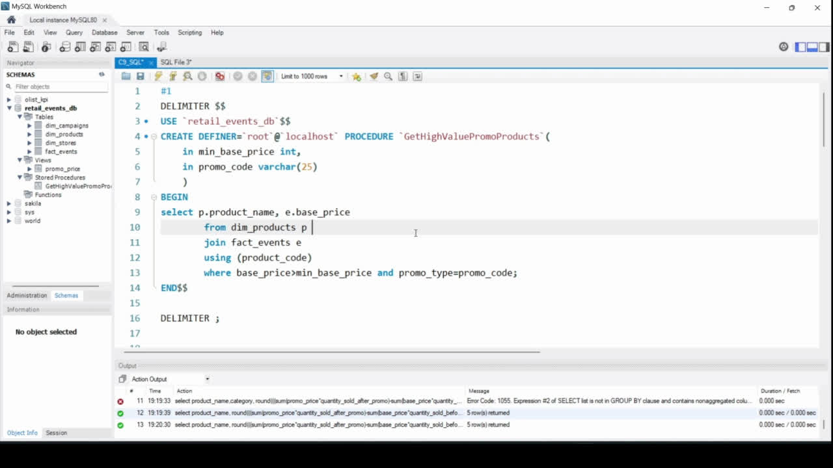

Slide 14
RECOMMENDATIONS
Store Distribution Optimization:
Considering the correlation between the number of stores and revenue, evaluate the performance of cities with a higher number of stores like Bengaluru. Assess if the market saturation is affecting incremental revenue and consider optimizing the store count in such cities.
Explore the potential for expanding in cities with fewer stores, especially in Trivandrum and Vijayawada, where the store count is low.
Focus on Madura City's Success Model:
Investigate the factors contributing to the high Incremental Revenue % in Madura City with only 4 stores. Identify successful strategies implemented in this city and consider replicating them in other cities, especially those with a similar store count.
Promotional Strategy:
Focus on optimizing the promotional strategy by leveraging the success of the "500 Cashback" promo type. Consider expanding and fine-tuning this type of promotion to maintain a healthy balance between Incremental Revenue and Incremental Sold Quantity.
Reevaluate and potentially adjust or discontinue promo types with negative trends, such as "33% OFF," "50% OFF," and "25% OFF." Analyze the reasons behind the decline and make data-driven decisions on whether to revamp or replace these promotions.
CUSTOMERS

Slide 15
RECOMMENDATIONS
Discount Strategy:
Reevaluate the discount strategy, especially for products where discount-based promotions are resulting in negative Incremental Revenue %. Assess whether the discounts are aligning with customer preferences or if adjustments are needed.
Given the success of the "500 Cashback" promo type with a lower average discount percentage, consider experimenting with lower discounts in other promotions to test their impact on revenue.
Continuous Monitoring:
Implement a system for continuous monitoring and evaluation of store performance, campaign effectiveness, and product/category trends. This will allow for quick adjustments based on evolving market dynamics.
CUSTOMERS

Slide 16

THANK YOU

